Slide 1
STOCK HUSTLE
PLATFORM
SEERA TARUN RAJ | INFOSYS SPRINGBOARD INTERN

Slide 2
Stock Hustle is a comprehensive platform aimed at simplifying stock market education.
Designed for beginners and seasoned investors alike, it serves as a one-stop solution for learning, analysis, and portfolio management.
By combining curated resources and advanced tools, Stock Hustle empowers users to make confident investment decisions.
WHAT IS STOCK HUSTLE?

Slide 3
Project Statement:
This project aims to create a user-friendly web application offering comprehensive tools for managing investment portfolios. It will provide real-time market data, portfolio tracking, market analysis, and educational resources, making the investment process easier for both novice and experienced investors.
Outcomes:
Enable users to create and manage investment portfolios.
Provide real-time stock market data for tracking performance.
Facilitate informed investment decisions with market analysis tools.
Enhance user engagement with educational resources and news.
Deliver a seamless, intuitive user interface for market and portfolio management.
ABSTRACT

Slide 4
Comprehensive Learning: Gain access to expertly curated articles and videos tailored to all levels of investors.
Practical Tools: Utilize features like portfolio management, real-time market tracking, and analysis tools.
Localized Resources: Multilingual content, including Telugu podcasts, ensures inclusivity and personalization.
User-Centric Design: A clean, responsive interface makes navigation simple and enjoyable.
WHY
STOCK HUSTLE?

Slide 5
PROBLEMS FACED BY INVESTORS
Real-time Data Integration: Difficulty managing data delays and ensuring accurate live updates.
Efficient Data Storage: High volumes of market data require efficient management.
User Retention: Attracting and retaining users requires engaging features and reliable services.

Slide 6
Complexity for Beginners: Many advanced platforms overwhelm new investors with complex interfaces and jargon.
High Costs: Most platforms are expensive, making them inaccessible for budget-conscious users.
Lack of Educational Tools: Few platforms provide comprehensive educational resources for all levels of investors.
DRAWBACKS OF CURRENT SYSTEMS

Slide 7
User-friendly Design: Catering to both new and experienced investors.
Secure Authentication: Login and registration system for user security.
Real-time Data Integration: Live stock market data and portfolio tracking.
Budget Management: Tools for tracking investment budgets and expenses.
Educational Resources: Accessible learning materials and market news.
PROPOSED SYSTEM FEATURES

Slide 8
Software Requirements:
Frontend: ReactJS, HTML, CSS, JavaScript
Backend: Spring Boot, Java
Database: MySQL
Hardware Requirements:
Development machine with at least 8 GB RAM, Core i5 processor (or equivalent), and 20 GB of free storage.
SYSTEM REQUIREMENTS

Slide 9
MODULE 1: USER AUTHENTICATION & REGISTRATION
FEATURES:
USER SIGN-UP AND LOGIN FUNCTIONALITY WITH SECURE AUTHENTICATION.
PASSWORD RECOVERY AND USER PROFILE MANAGEMENT.
MODULE 2: PORTFOLIO MANAGEMENT
FEATURES:
USERS CAN CREATE AND MANAGE PORTFOLIOS.
TRACK STOCK HOLDINGS, PROFIT/LOSS CALCULATIONS, AND PORTFOLIO PERFORMANCE ANALYSIS.
MODULE 3: STOCK MARKET DATA & VISUALIZATION
FEATURES:
REAL-TIME DATA RETRIEVAL FROM MARKET SOURCES.
INTERACTIVE CHARTS AND GRAPHS FOR STOCK PERFORMANCE VISUALIZATION.
MODULES

Slide 10
MODULE 4: BUDGET MANAGEMENT
FEATURES:
TRACK INVESTMENT BUDGETS AND EXPENSES.
MONITOR PORTFOLIO ALLOCATION TO ENSURE BALANCED INVESTING.
MODULE 5: NOTIFICATION SYSTEM (FUTURE SCOPE)
FEATURES:
SET ALERTS FOR STOCK PRICE CHANGES, MARKET MOVEMENTS, AND CUSTOMIZED METRICS.
GET REAL-TIME NOTIFICATIONS ON MARKET TRENDS AND PORTFOLIO UPDATES.
MODULE 6: LEARNING RESOURCES
FEATURES:
EDUCATIONAL CONTENT FOR ALL EXPERIENCE LEVELS, FROM BEGINNER TUTORIALS TO ADVANCED STRATEGIES.
MARKET NEWS, ANALYSIS, AND INSIGHTS FOR INFORMED DECISION-MAKING.
MODULE 7: DASHBOARD
FEATURES:
USER-FRIENDLY DASHBOARD DISPLAYING REAL-TIME STOCK DATA.
EASILY VIEW MARKET TRENDS AND PORTFOLIO
MODULES

Slide 11
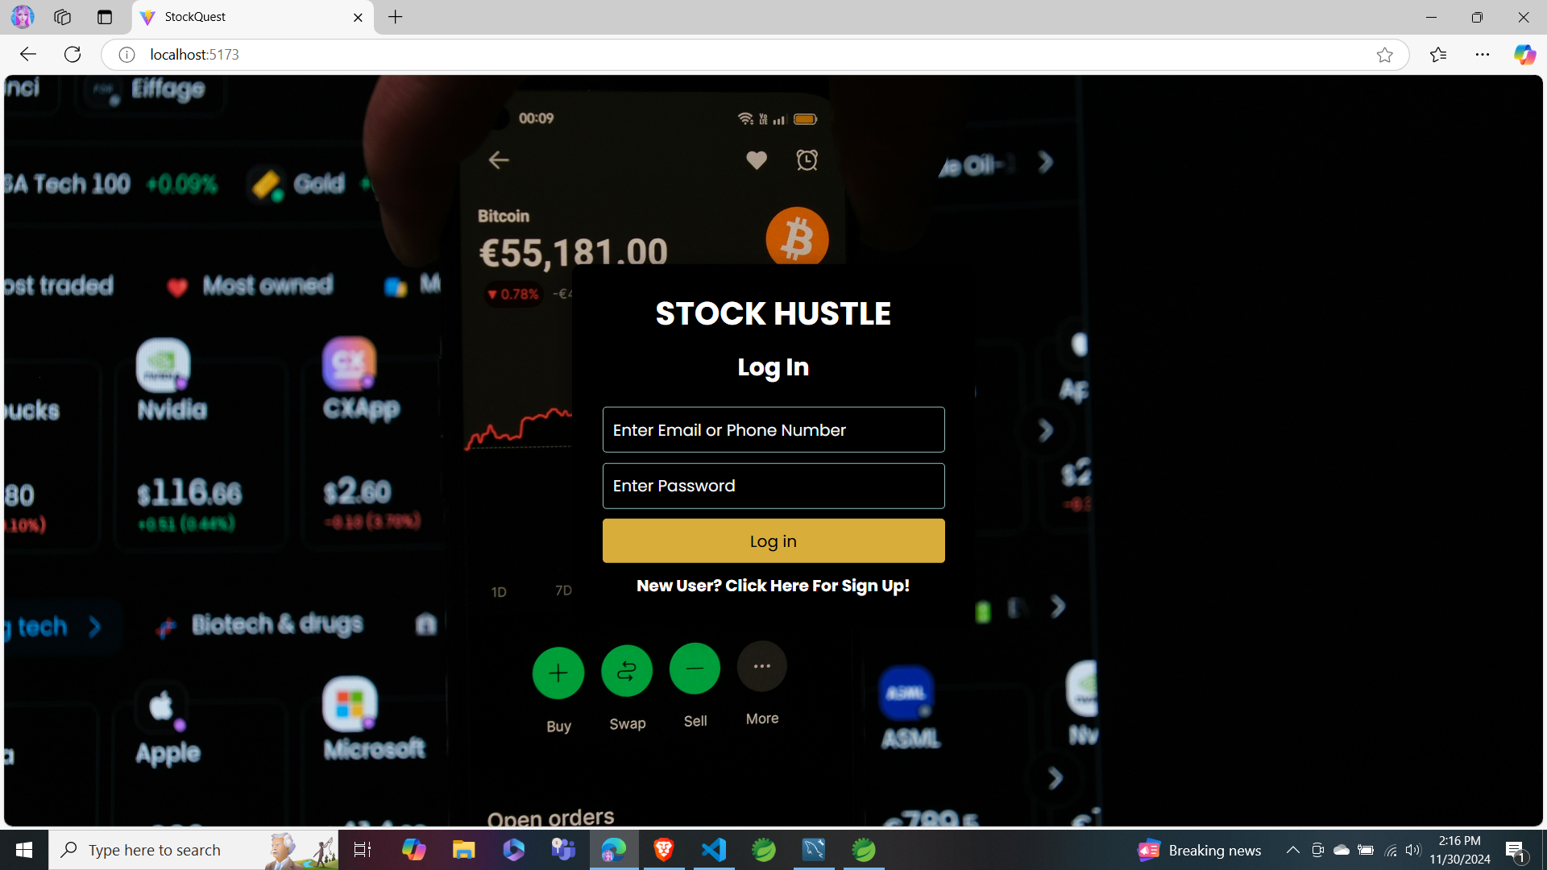
LOGIN

Slide 12
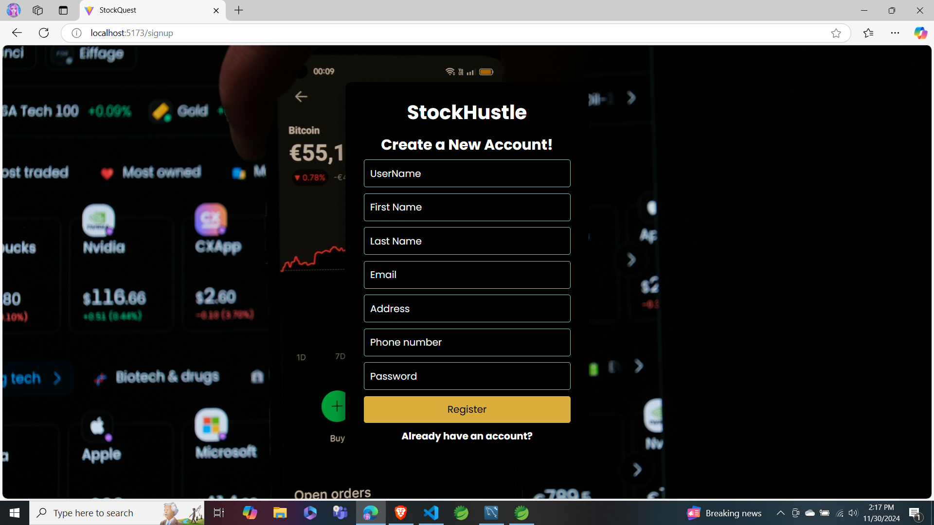
LOGIN

Slide 13
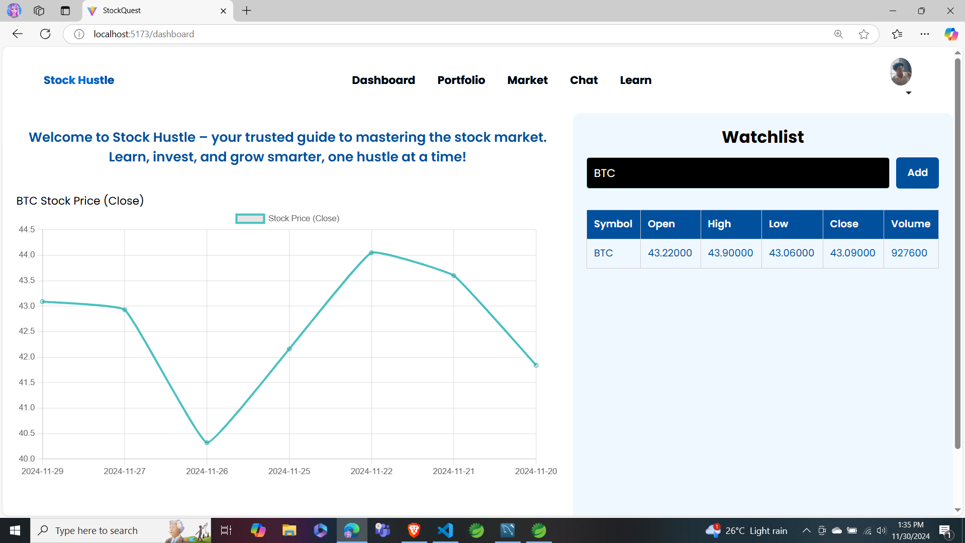
DASHBOARD

Slide 14
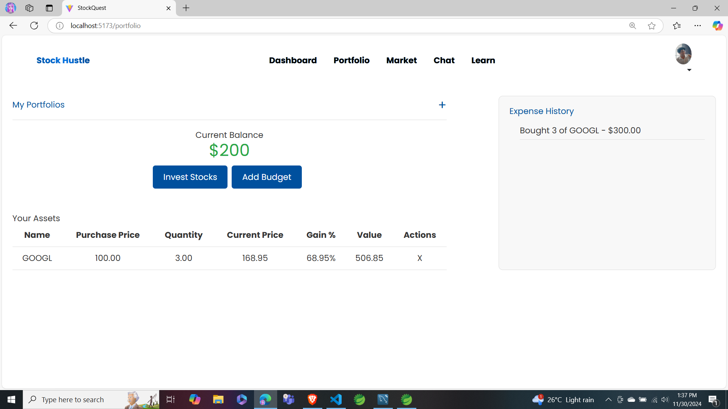
PORTFOLIO

Slide 15
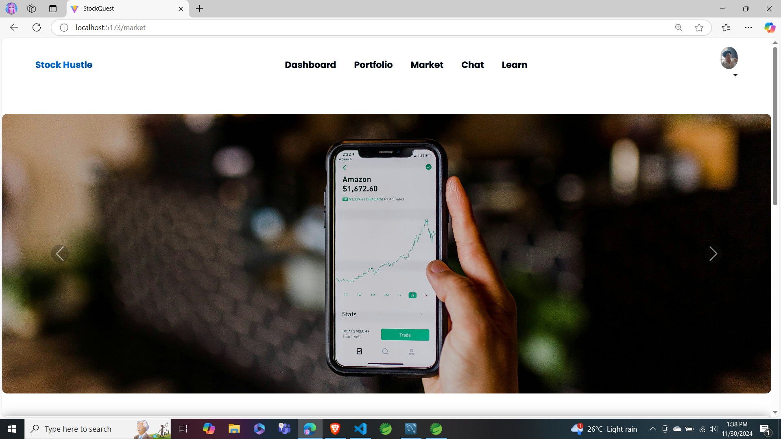
MARKET

Slide 16
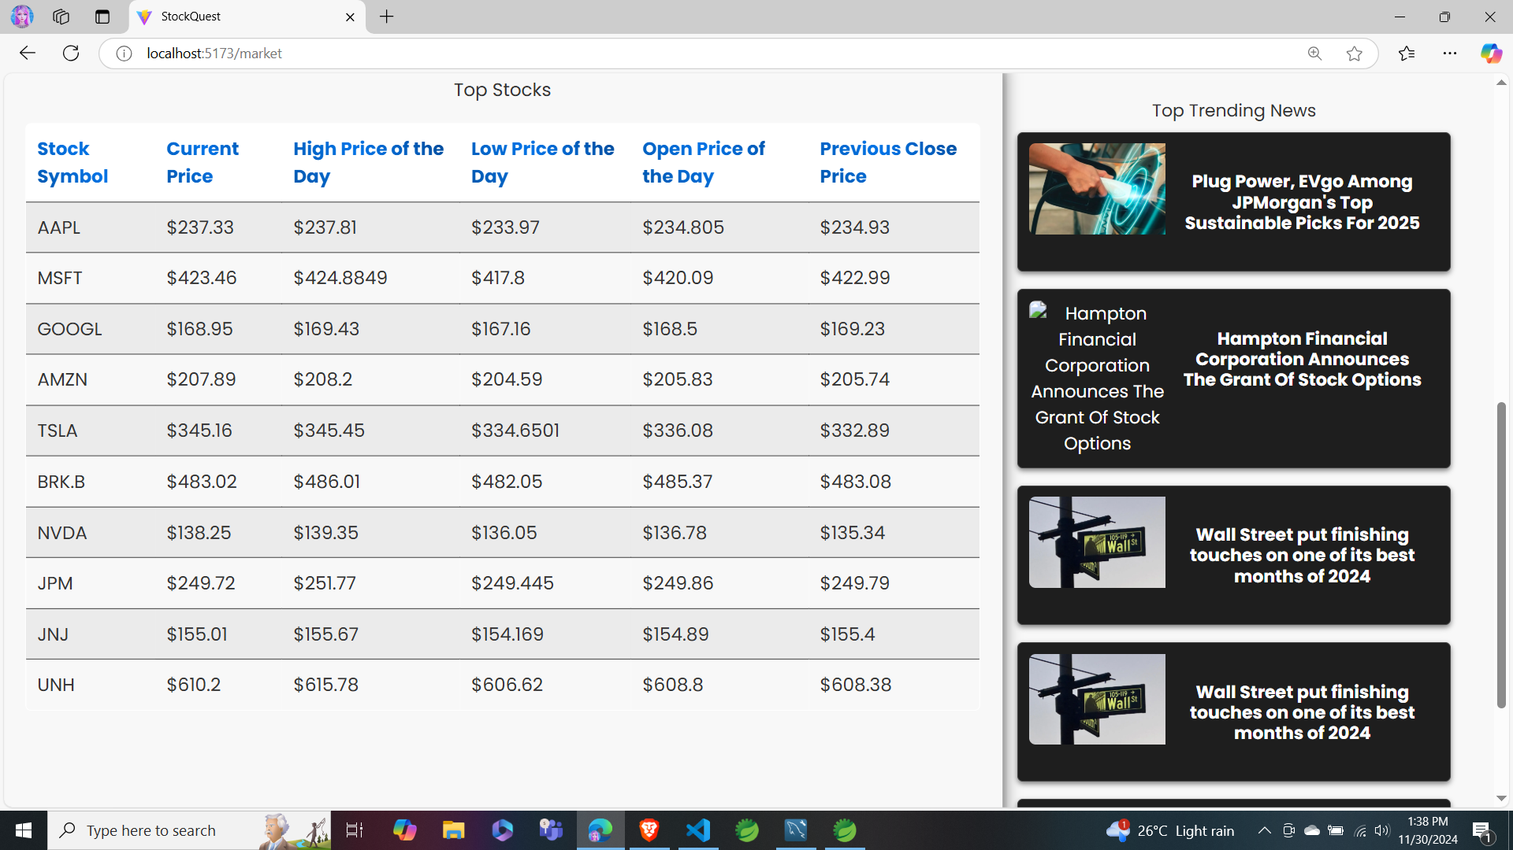
MARKET

Slide 17
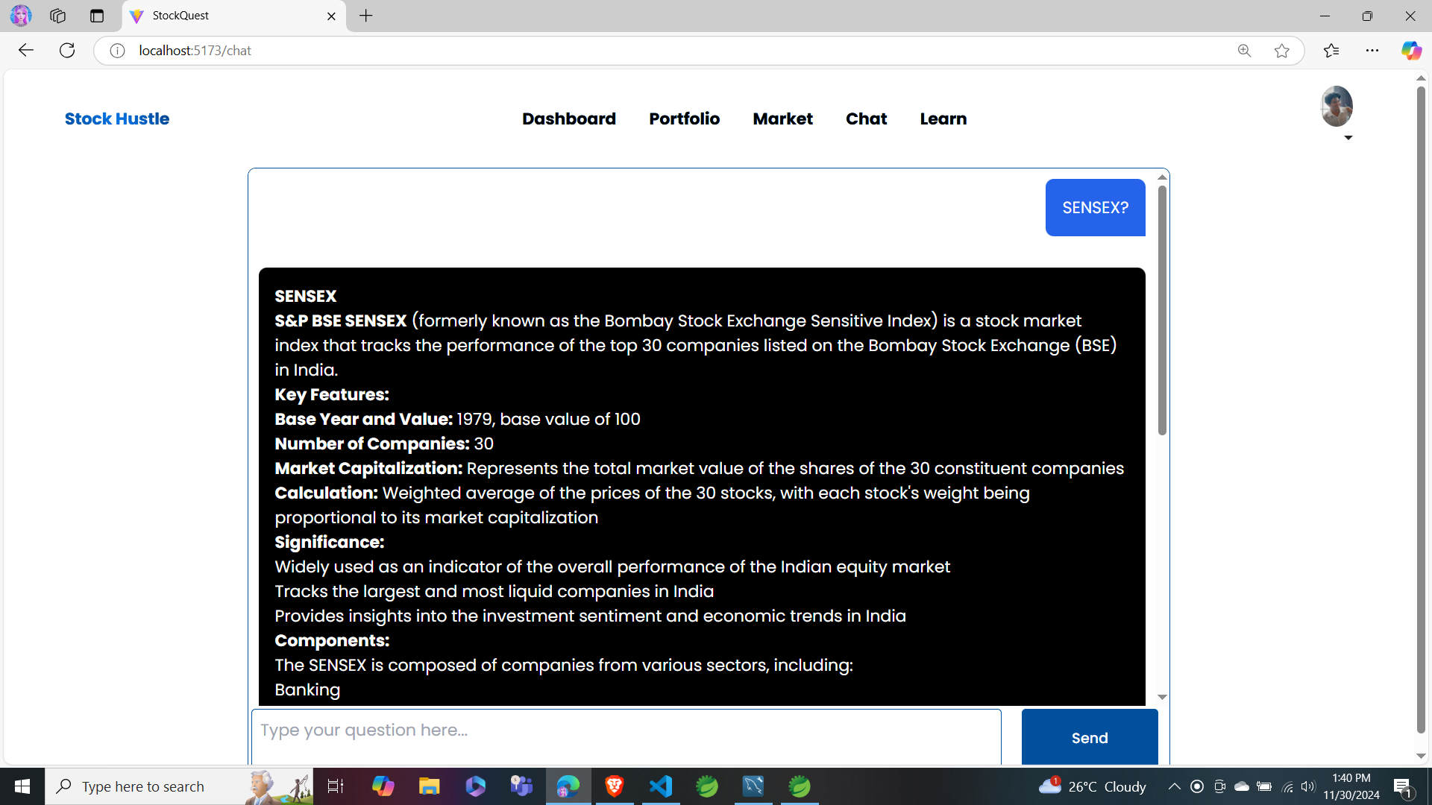
CHAT SUPPORT

Slide 18
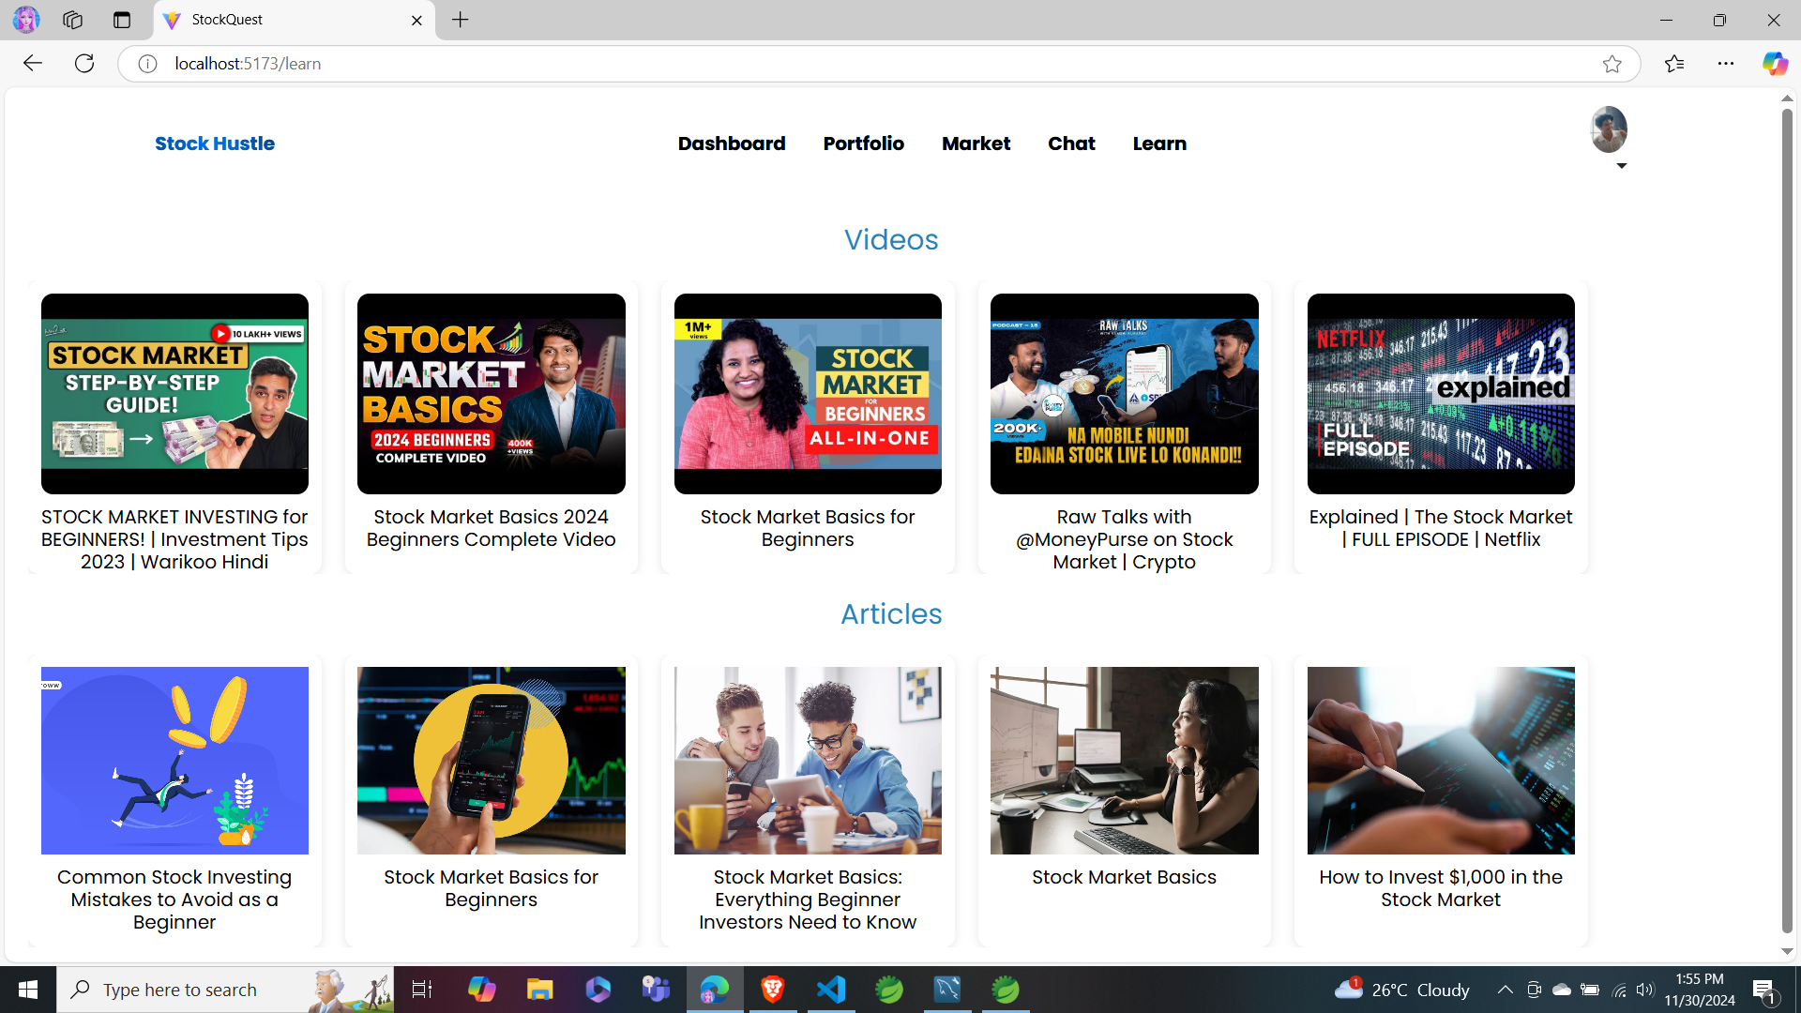
LEARN

Slide 19
STOCK HUSTLE IS A PLATFORM THAT EMPOWERS BOTH NEW AND EXPERIENCED INVESTORS.
WITH REAL-TIME DATA, EDUCATIONAL RESOURCES, AND BUDGET MANAGEMENT TOOLS, USERS CAN MAKE INFORMED INVESTMENT DECISIONS AND TRACK THEIR PORTFOLIOS EFFICIENTLY.
CONCLUSION

Slide 20
THANK YOU

